Slide 1
Earthquakes Presented By: Thanh Le December 2017

Slide 2
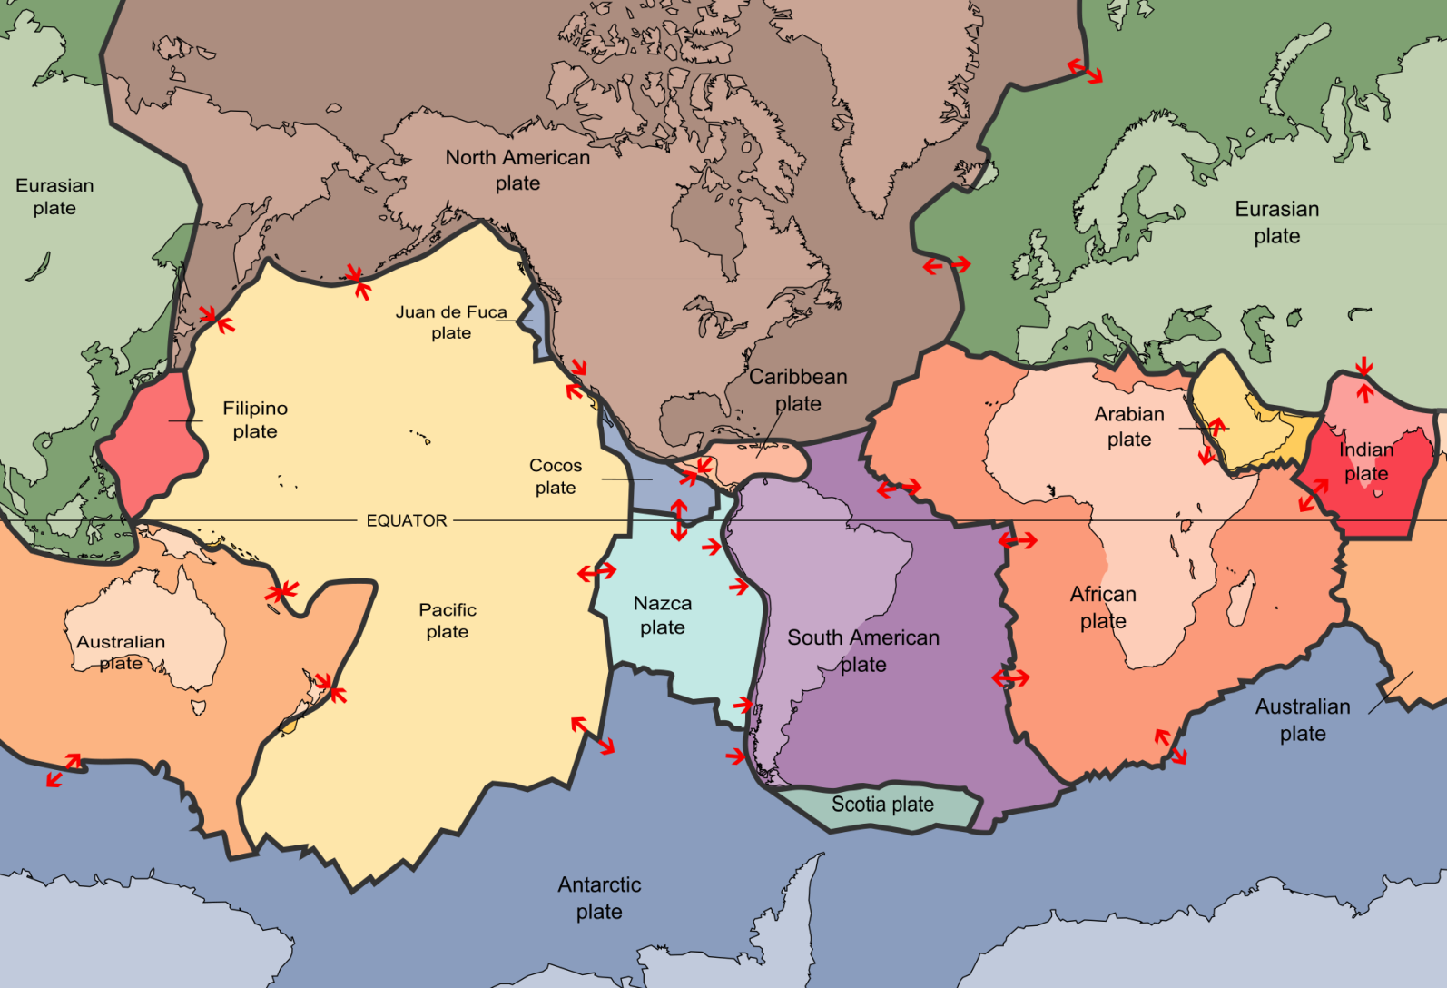
Earth Tectonic Plates

Slide 3
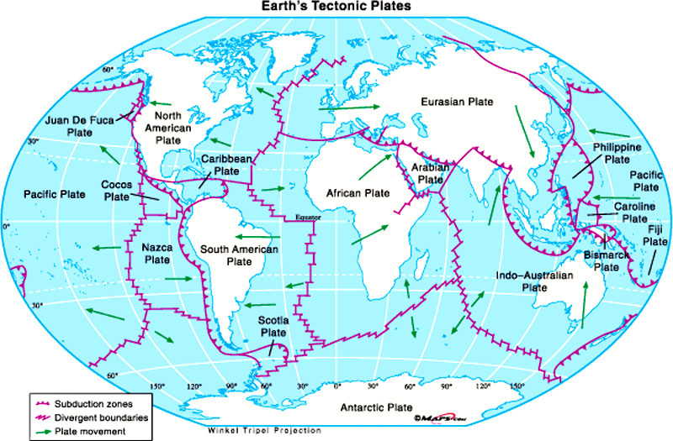
Earth Tectonic Plates

Slide 4

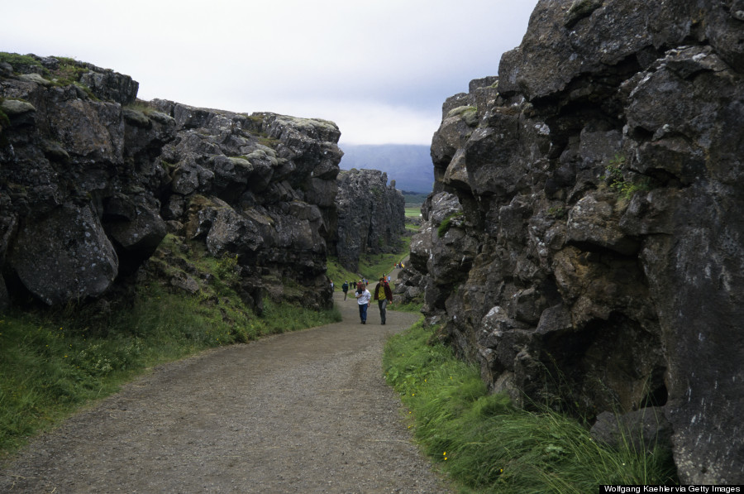
North-American meets Eurasian

Slide 5

How do we measure earthquakes?
Richter Scale (1934)
measures Magnitude of an earthquake (from 0 to 10)
each measure is 10 times as powerful as the previous measure, and 32 times more energy released
Ex. Magnitude 1 releases the energy similar to the explosion from 6 ounces of TNT, Magnitude of 8 is as much energy as detonating 6 millions tons of TNT

Slide 6
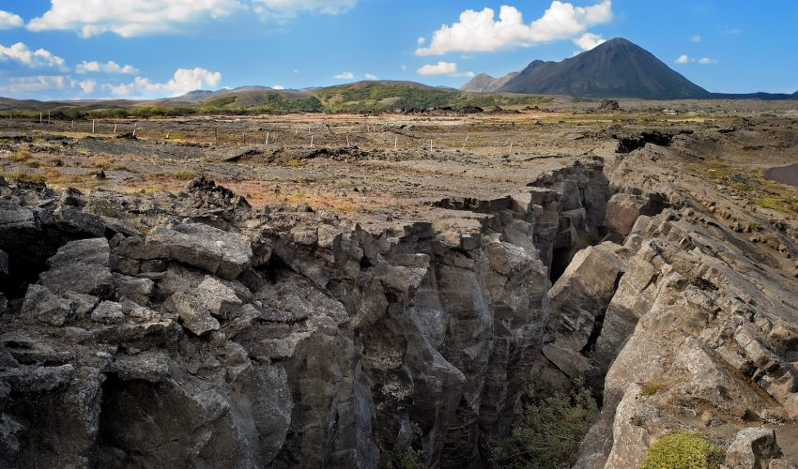
Now let’s take a look at
some fascinating data …

